Slide 1

Deep Q-Networks for Intelligent Decision-Making
Supervised by:
Presented by:
SENTHIL G A
SIMATS Engineering
DASARI HARITHA(192425254)
SIMATS Engineering

Slide 2


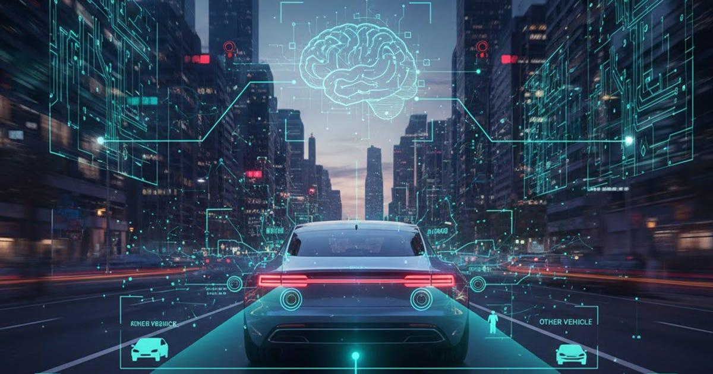
WHAT IS DEEP Q-NETWORK (DQN)
Deep Q-Networks (DQN) for Intelligent Decision-Making
DQN combines Deep Learning + Q-Learning
Used to make intelligent decisions through trial and error
Agent learns from states, actions, and rewards
Suitable for complex environments
Used in robotics, autonomous vehicles, and smart manufacturing
Key idea: State → DQN → Action → Reward → Learning

Slide 3
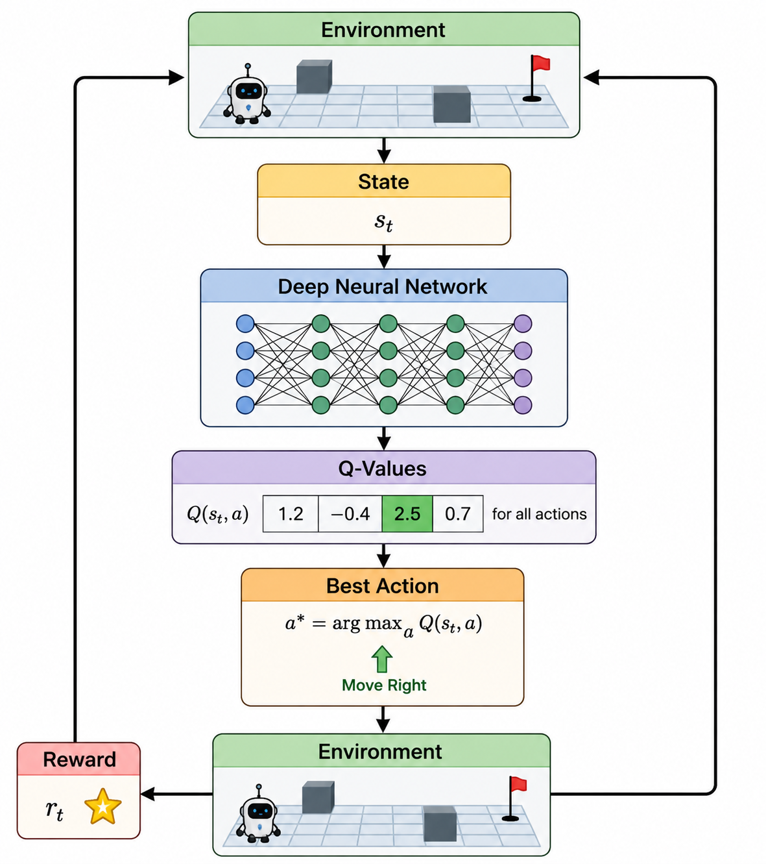
DQN ARCHITECTURE

Slide 4
EXPERIENCE REPLAY
What is Experience Replay?
DQN stores previous experiences in a Replay Memory.
Each experience contains:
(State, Action, Reward, Next State)
Working:
Agent interacts with Environment
↓
Store Experience
↓
Replay Memory
↓
Random Mini-Batch
↓
Train Neural Network

Slide 5
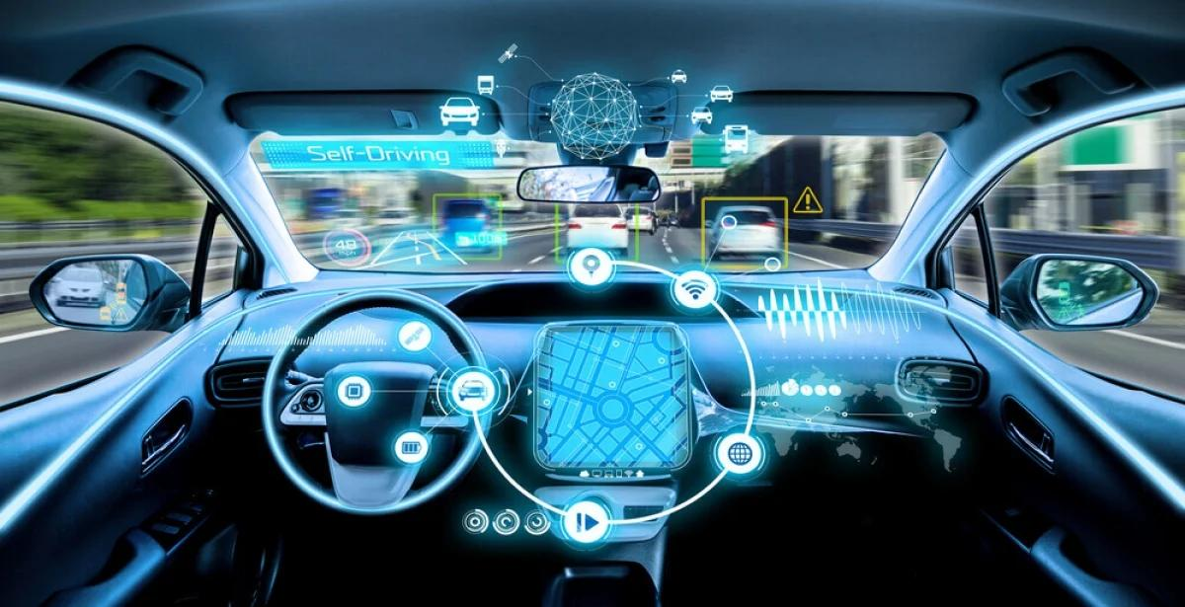
TARGET NETWORKS
Why Target Network?
DQN uses two networks:
1. Online Network
Learns continuously
Predicts current Q-values
2. Target Network
Provides stable target values
Updated periodically from the online network
Benefits
Reduces training instability
Prevents rapidly changing targets
Improves convergence
Provides more reliable Q-value learning

Slide 6
APPLICATIONS & CONCLUSION
APPLICATIONS
🤖 Robotics – Robot navigation and path planning
🚗 Autonomous Vehicles – Obstacle avoidance and driving decisions
🏭 Smart Manufacturing – Machine control and production optimization
📦 Warehouse Automation – Robot movement and task scheduling
CONCLUSION
DQN combines Deep Learning and Q-Learning.
It learns the best action from experience.
Experience Replay improves learning.
Target Networks provide stable training.

Slide 7
THANK YOU!

